Slide 1

Introduction & Passive Components
Intro to DIY Circuit Design
Zhiyang Tsao
Summer 2024

Slide 2

About me
陈 悦开 / Pieski
Electronic Information Engineering,
College of EE, Zhejiang Univ.
Terrible at almost everything
E-mail: tsaozy@zju.edu.cn / tinesharp@outlook.com
Github: https://github.com/Pieski
Wechat: “脑子有坑”in every xlab wechat group

Slide 3

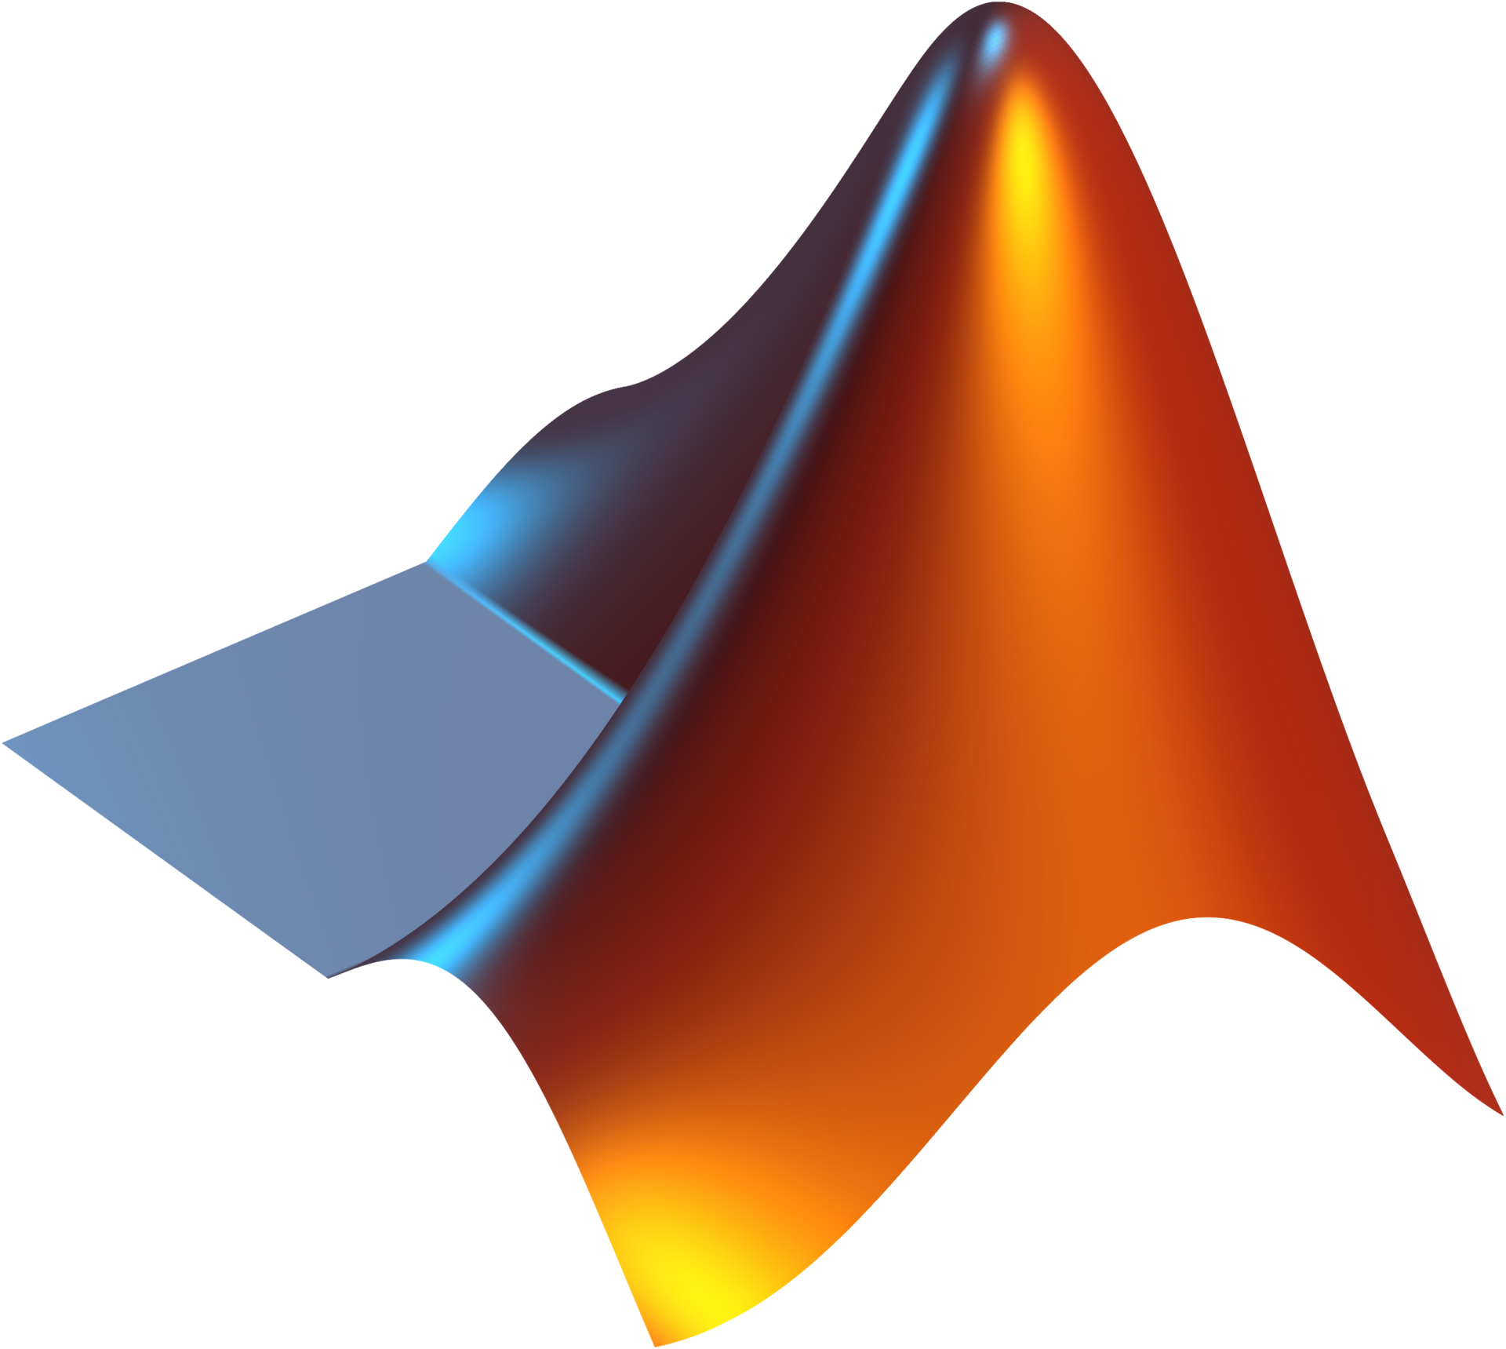


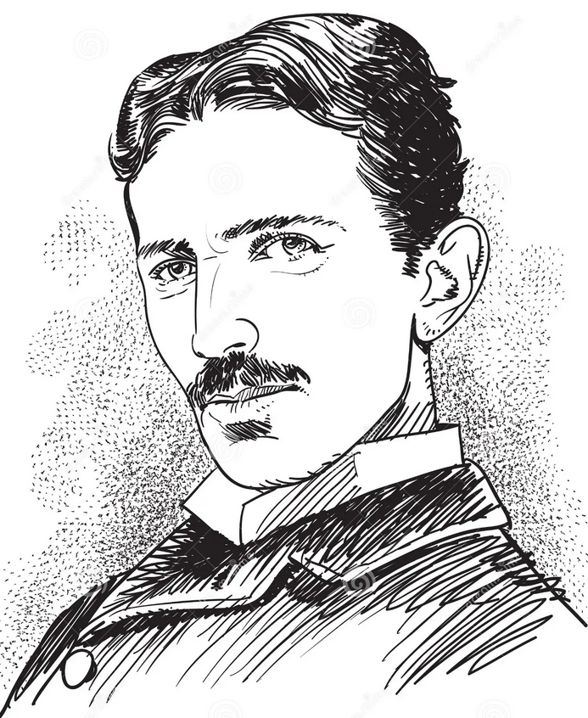
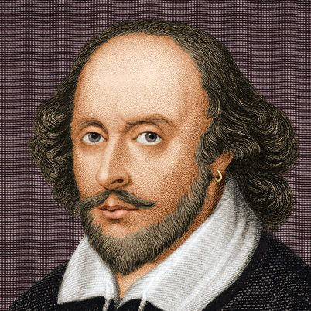

About this program
A brief introduction to the basic electronic engineering
Multiple DIY-level designs
A tutorial of design and simulation tools
A little bit math

Slide 4
On what level do we design?
“Software”
Product
Device on sale
Embedded System
System Level
Module
Too soft
Too big
Too easy
Hardware
Circuit Level
PCBA
Too hard
Too specific
Too hard
Physics, electro-chemistry
IC design
Discrete transistors
Semiconductor
Fricking vacuum tubes

Slide 5
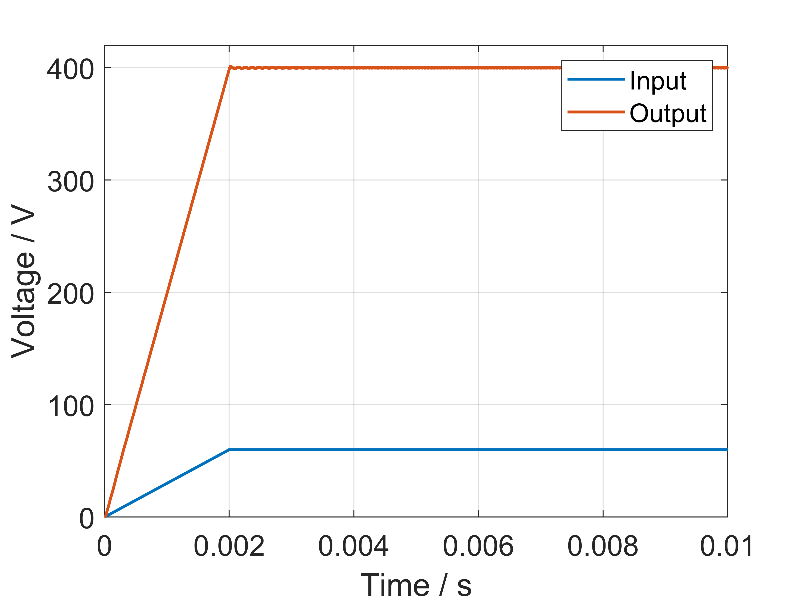
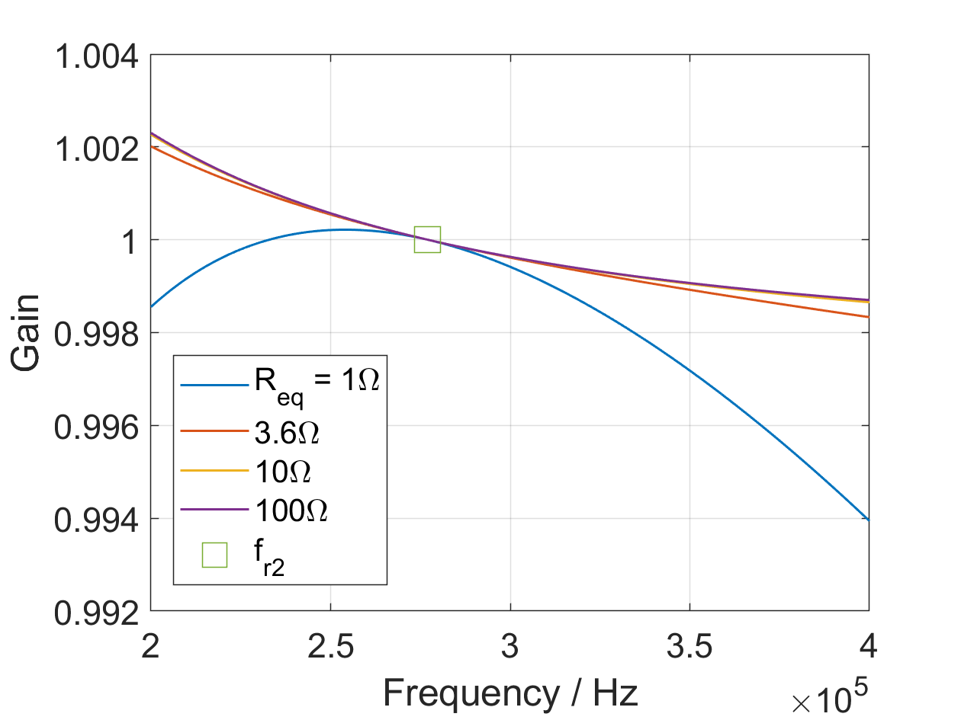
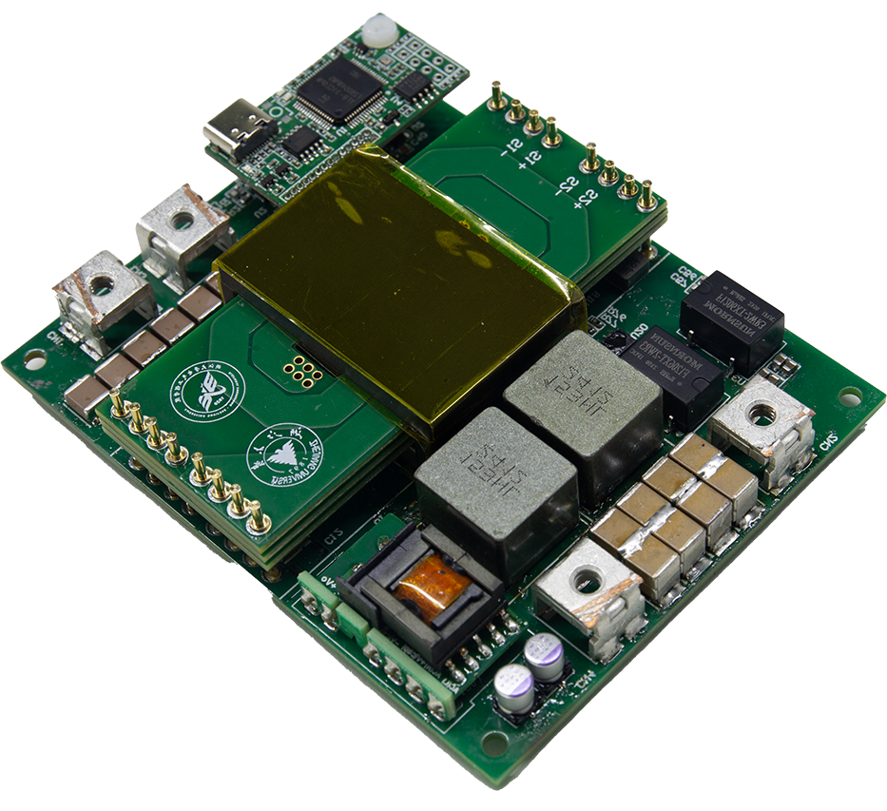
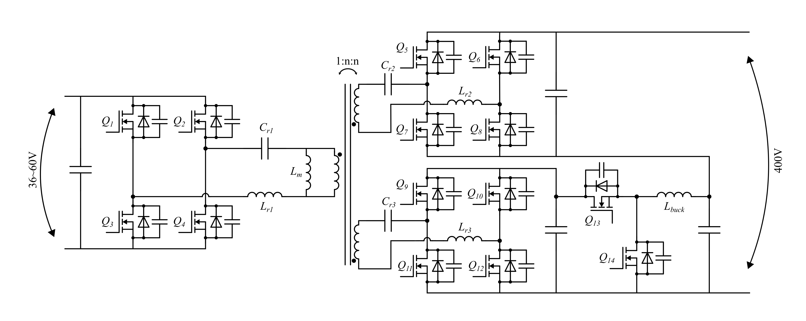
Example: Power Supply
1kW Bidirectional Isolated DC/DC Converter
2024

Slide 6
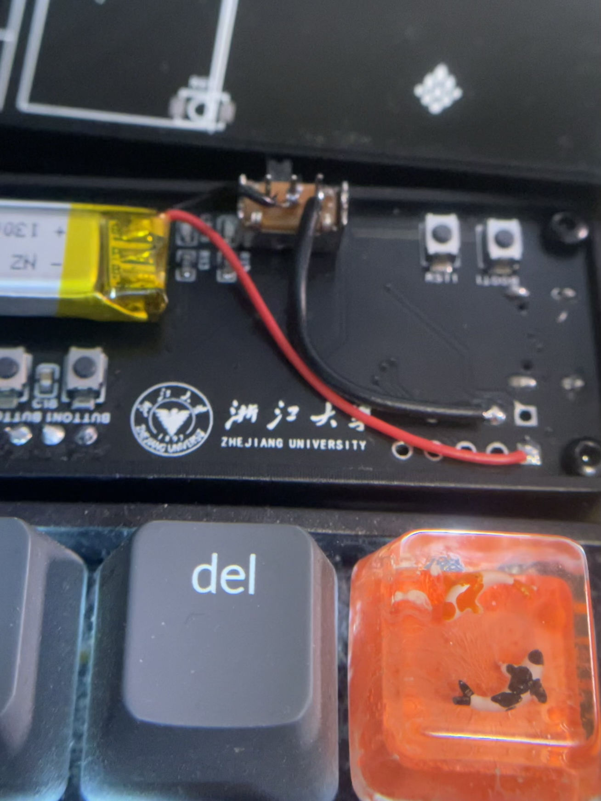
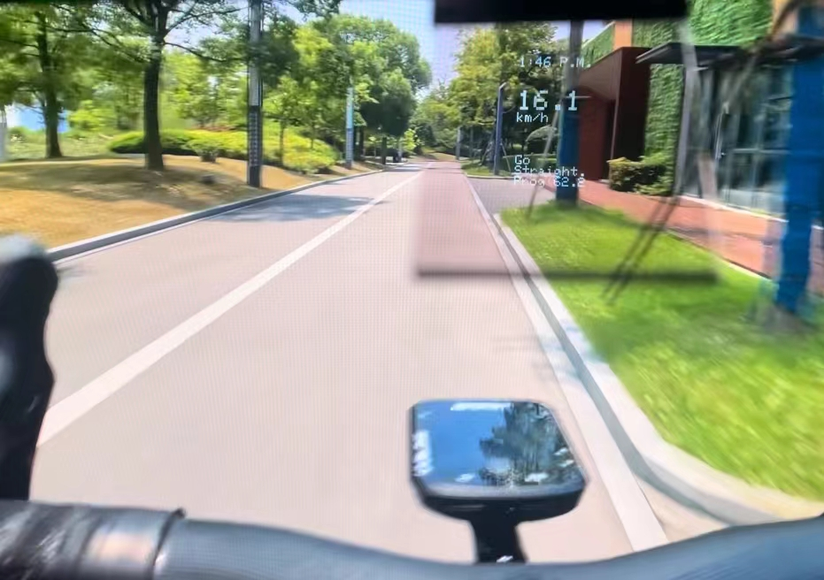
Example: Embedded Hardware
PCBs
AR-Track
2024 bwg
https://github.com/AAAAyl0n/AR-Track

Slide 7
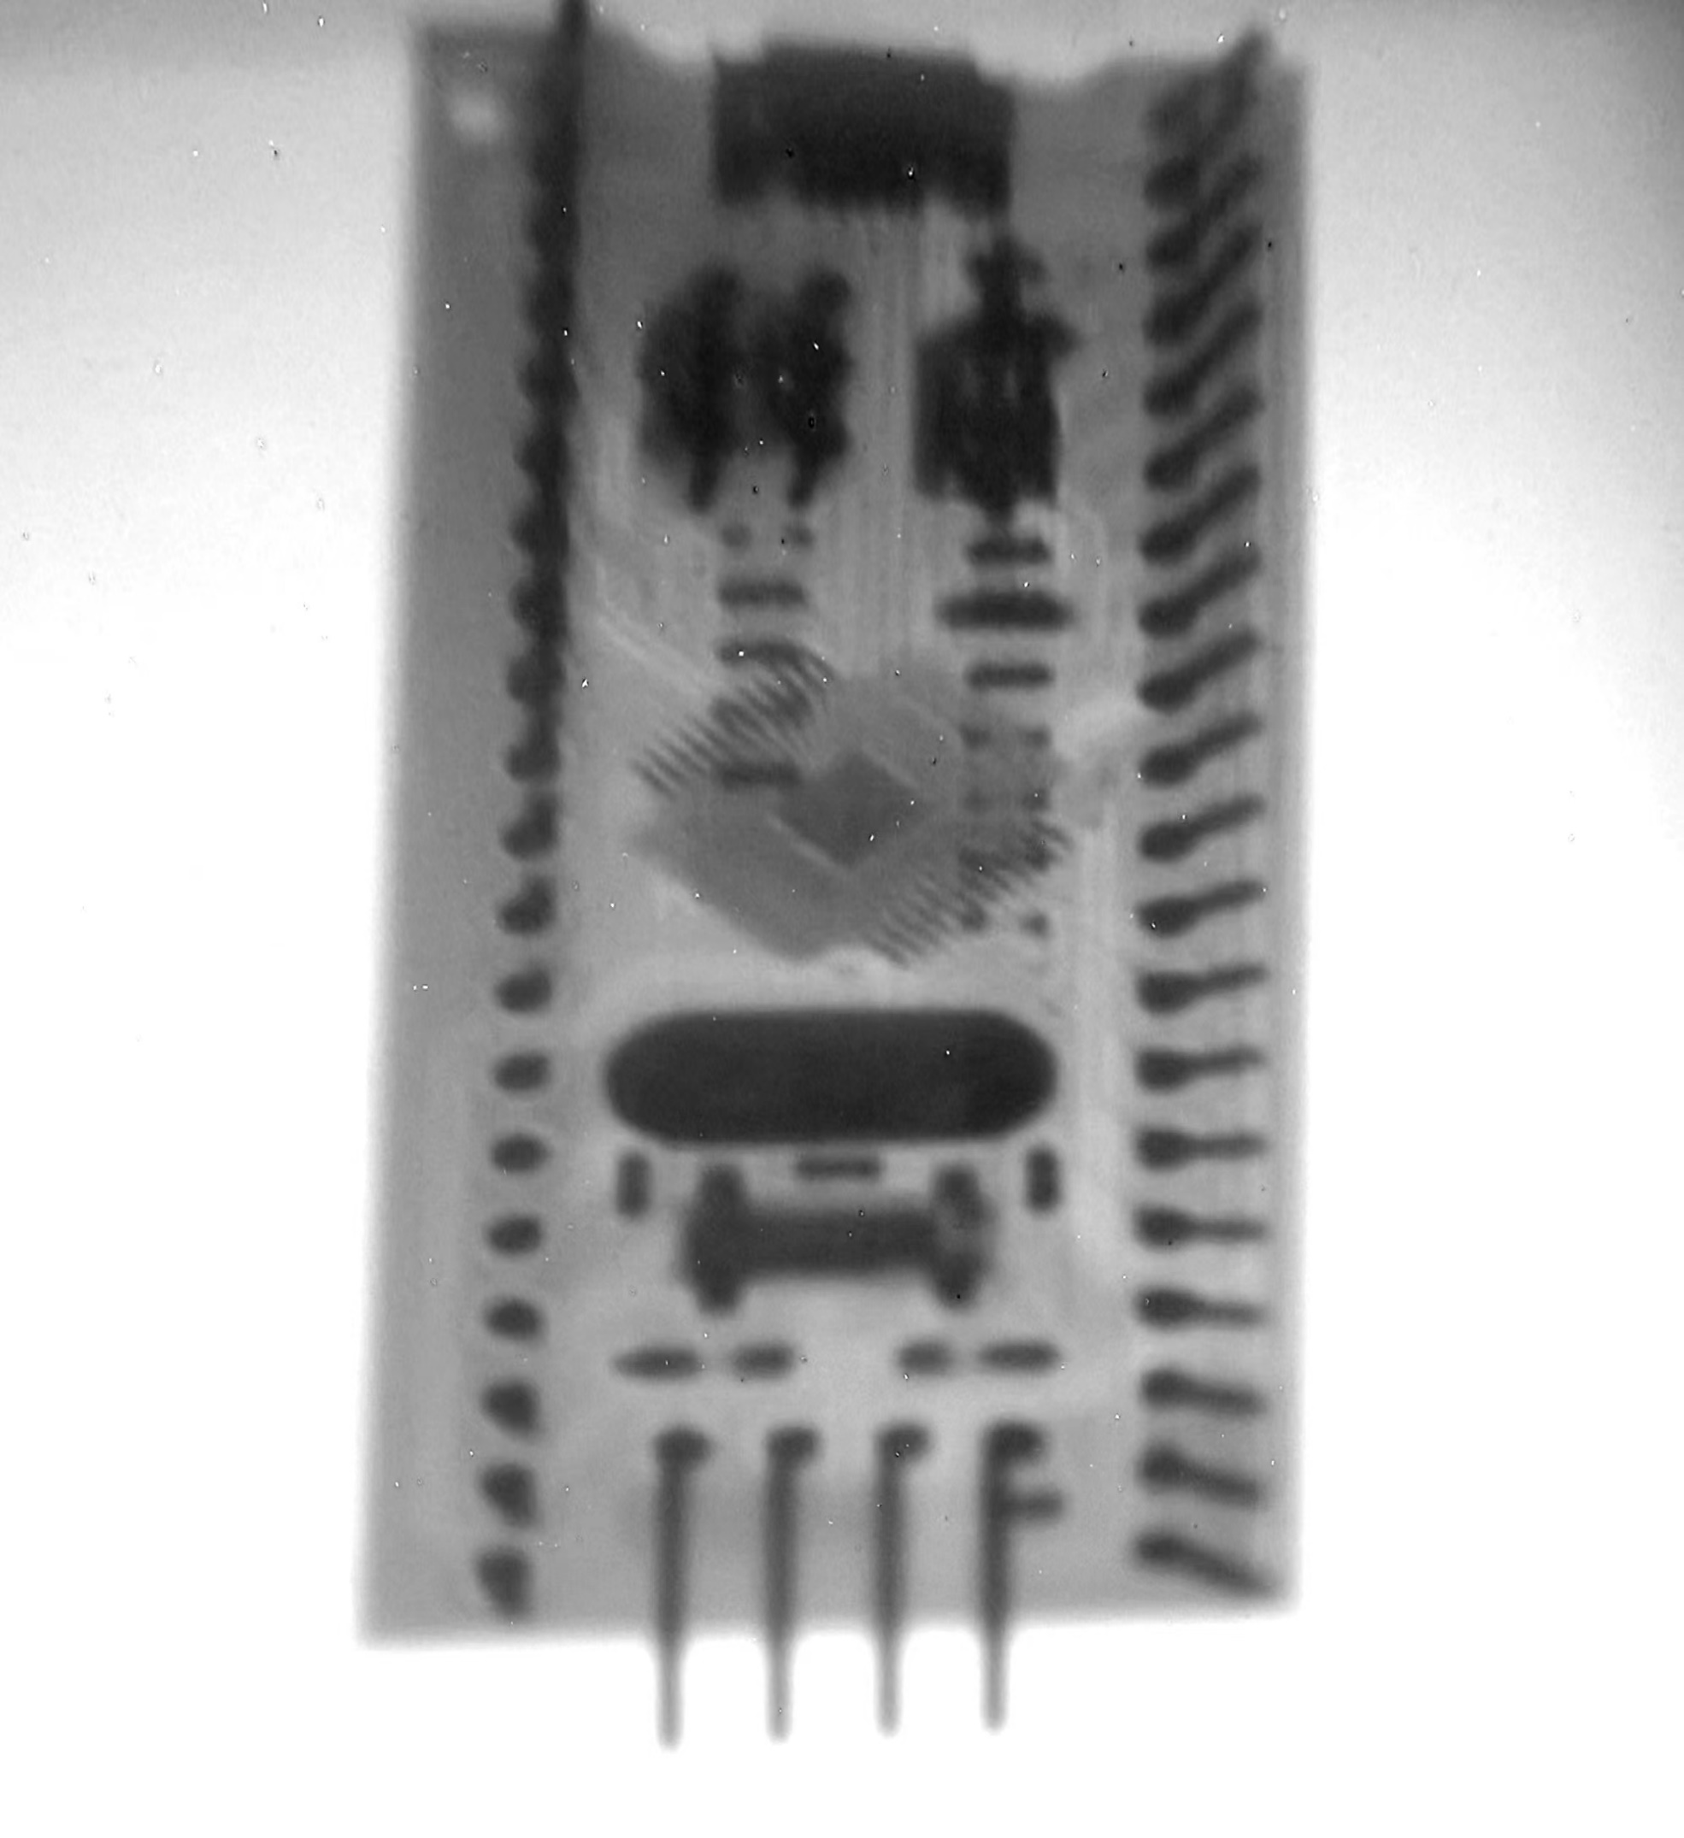
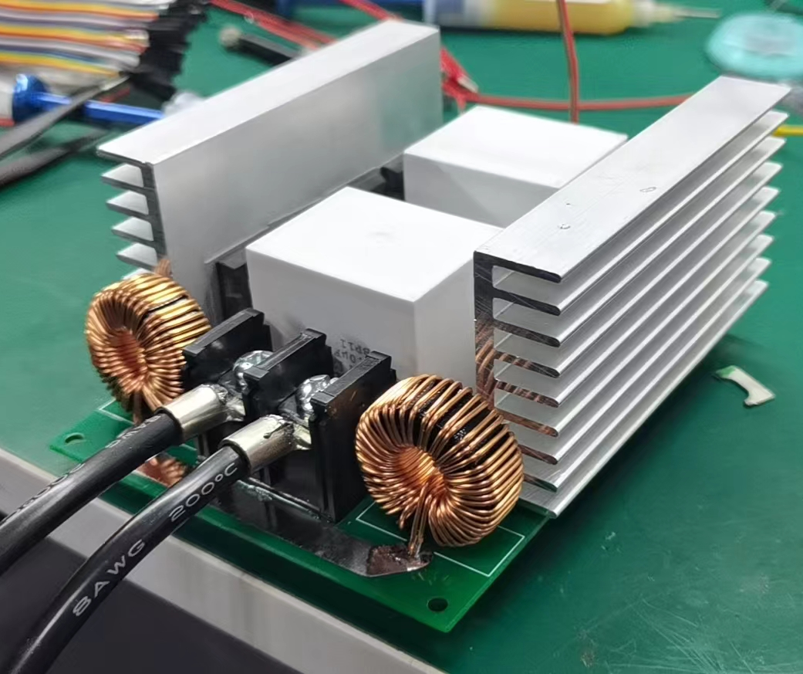
Example: Crazy Ideas
60kV 100W Xray
2022

Slide 8
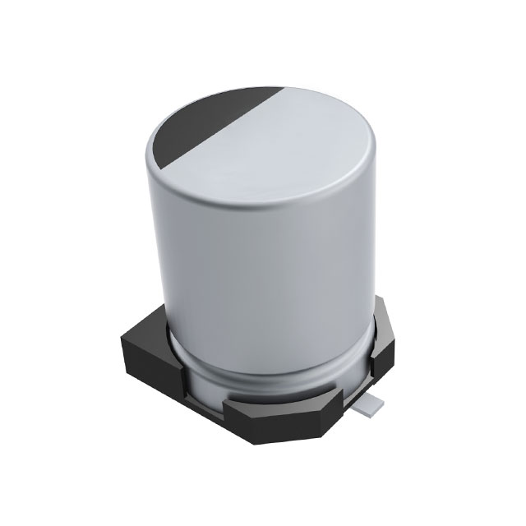
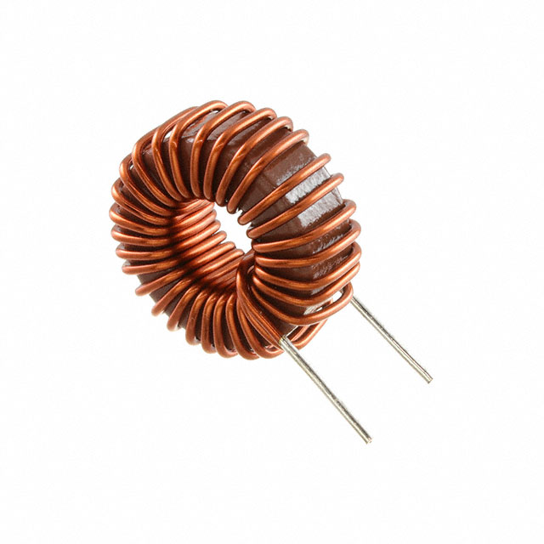
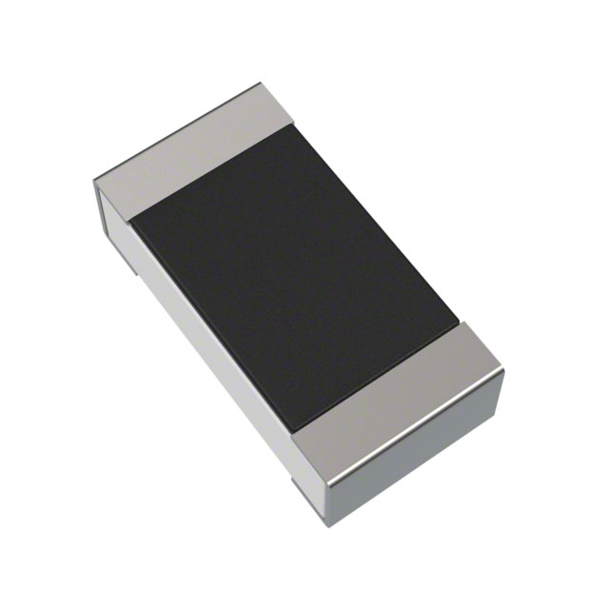
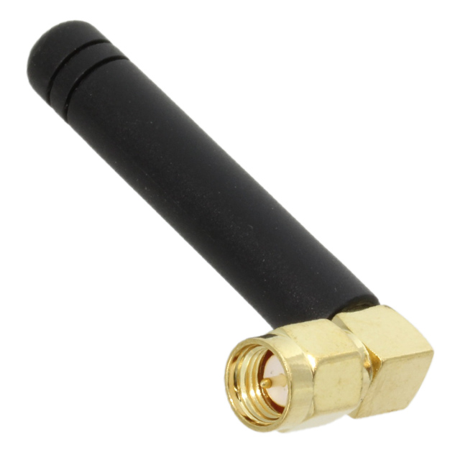
Passive Components
Passive = It only receives energy / it needs no auxiliary supply /
it is incapable of power gain
Resistor
电阻
Capacitor
电容
Inductor
电感
Antenna
天线

Slide 9
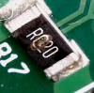
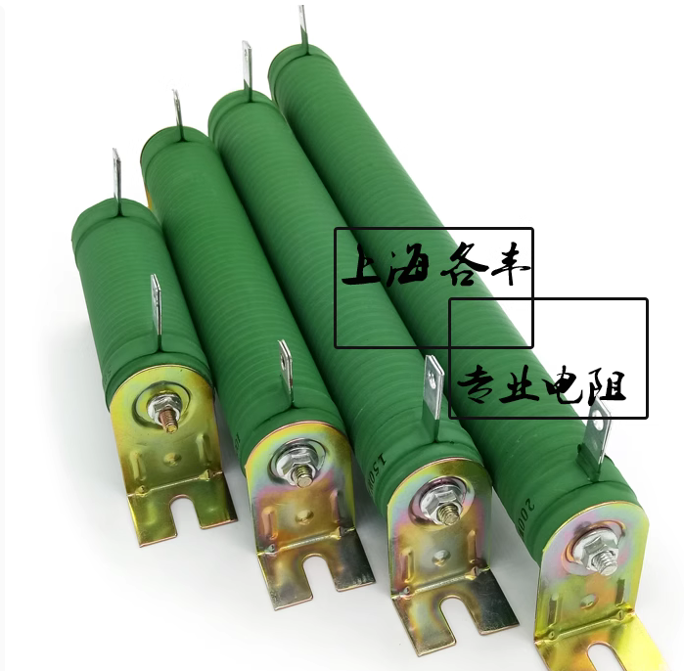
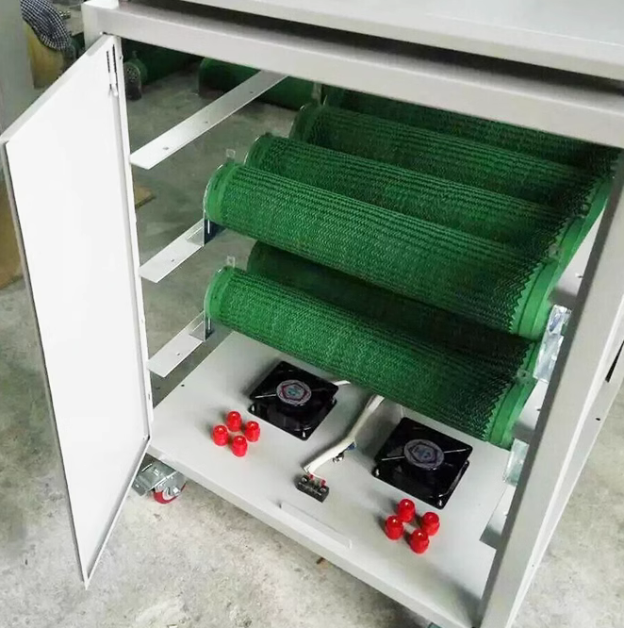
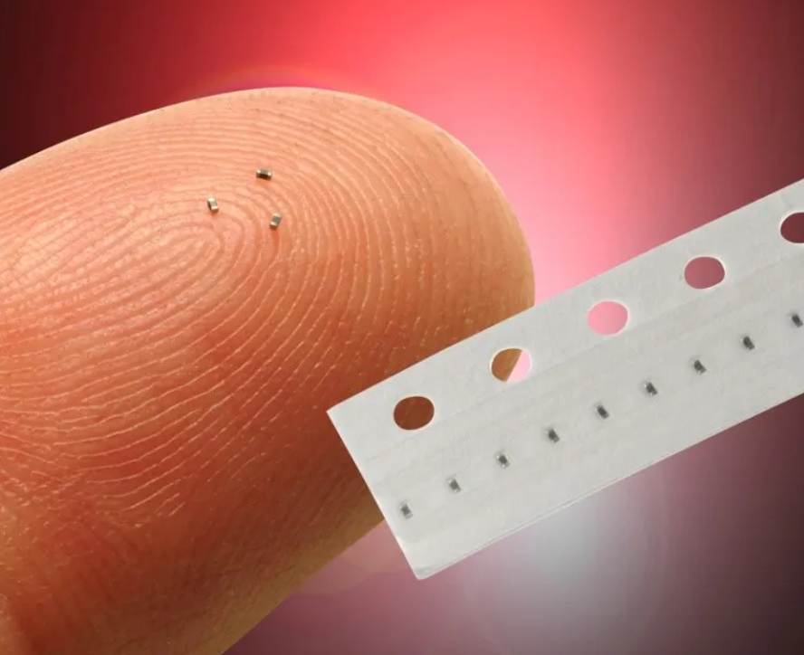
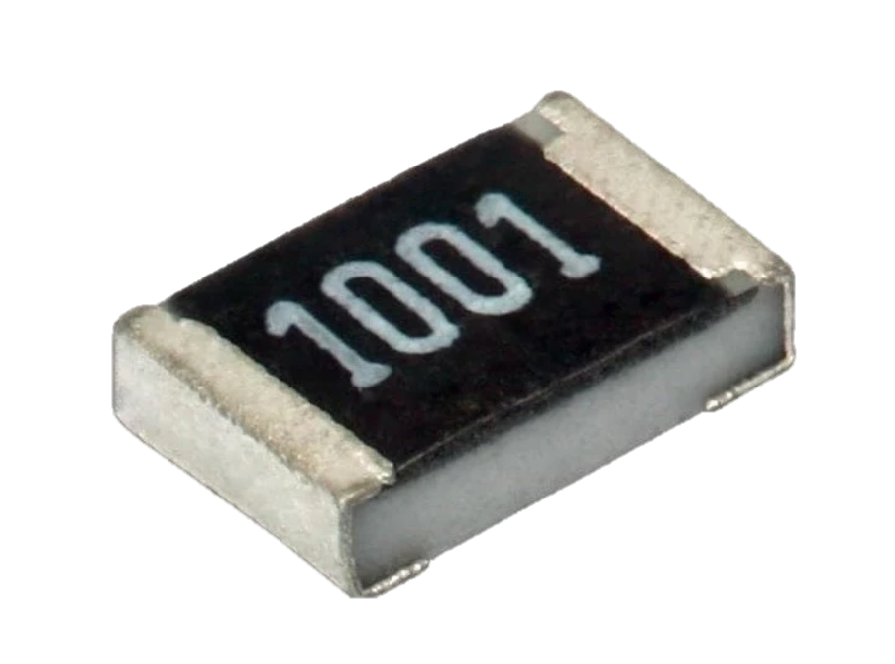
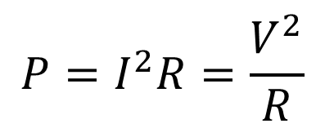
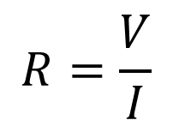
Resistor
$$R=\frac{V}{I}$$
$$P=I^{2}R=\frac{V^{2}}{R}$$
What else?
Always beware of power dissipation!
The higher the loss, the larger the size.
Otherwise raised temeperature would damage the resistor irreversible.
Fan
R0201
P<0.05W
Tubular Ceramic Resistor
瓷管电阻，50W~1kW
Resistive Load Bank
负载箱子, ~100kW

Slide 10
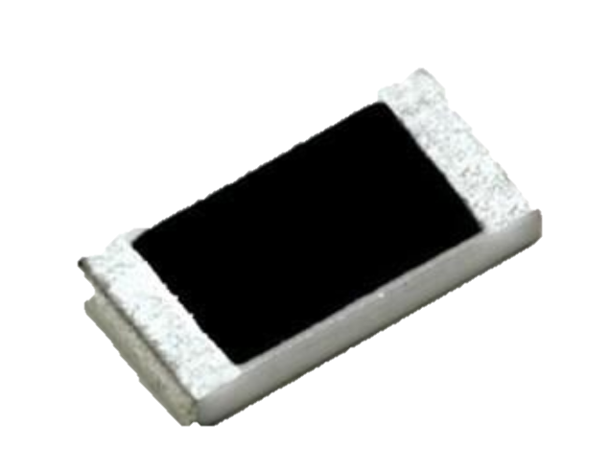
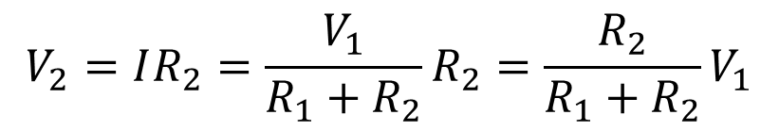
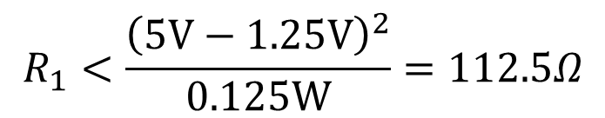
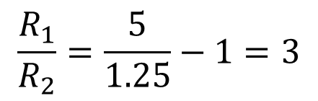
Calculation!
For this moment that menas it needs roughly no current.
Suppose we have a CMOS sensor that requires some 1.25V reference voltage.
But I only got a 5V supply. What to do?
$$V_{2}=IR_{2}=\frac{V_{1}}{R_{1}+R_{2}}R_{2}=\frac{R_{2}}{R_{1}+R_{2}}V_{1}$$
$$\frac{R_{1}}{R_{2}}=\frac{5}{1.25}−1=3$$
It only tells us the ratio!
At XLAB we prefer 0805 resistor
For R0805, P<1/8W
$$R_{1}<\frac{{\left(5V−1.25V\right)}^{2}}{0.125W}=112.5Ω$$
A basic resistive voltage divider

Slide 11
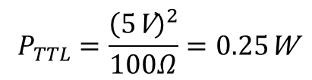
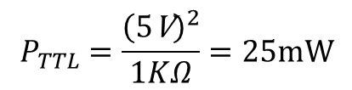
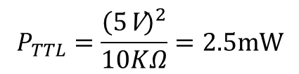
Easier approach
At XLAB we prefer 0805 resistor
For R0805, P<1/8W
永铭 prefers 0603 resistor
P<1/10W
In future you might need R0201
P<1/20W
Approach for the lazy is to start with 10KΩ. It works for most scenarios.
$$P_{TTL}=\frac{{\left(5\text{V}\right)}^{2}}{10KΩ}=2.5mW$$
$$P_{TTL}=\frac{{\left(5\text{V}\right)}^{2}}{1KΩ}=25mW$$
$$P_{TTL}=\frac{{\left(5\text{V}\right)}^{2}}{100Ω}=0.25\text{W}$$
Harmless
Worth attention
Unaccepctable
Beware that 2.5mW is still too high
for certain μW-level ultra low power
applications.
Sometimes you have to compromise
between loss and speed

Slide 12
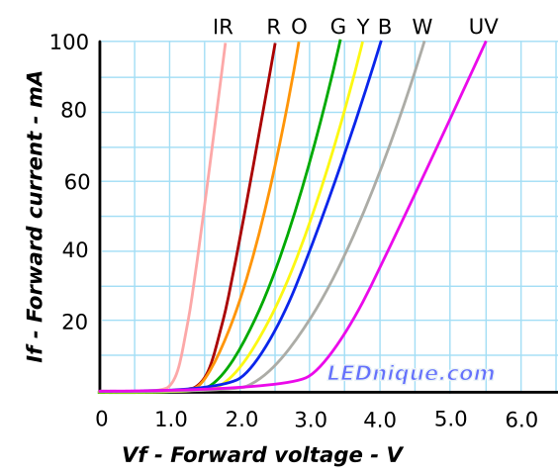
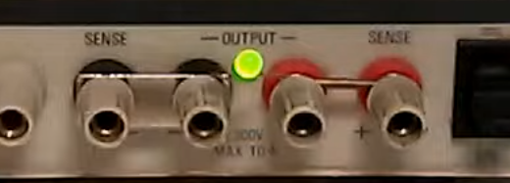
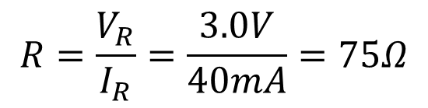
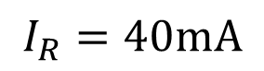
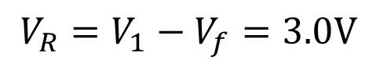
More calculation
Suppose we want a red LED works on
Vf = 2.0V & If = 40mA
$$V_{R}=V_{1}−V_{f}=3.0V$$
$$I_{R}=40mA$$
$$R=\frac{V_{R}}{I_{R}}=\frac{3.0V}{40mA}=75Ω$$
This chart is plotted for large LEDs!

Slide 13
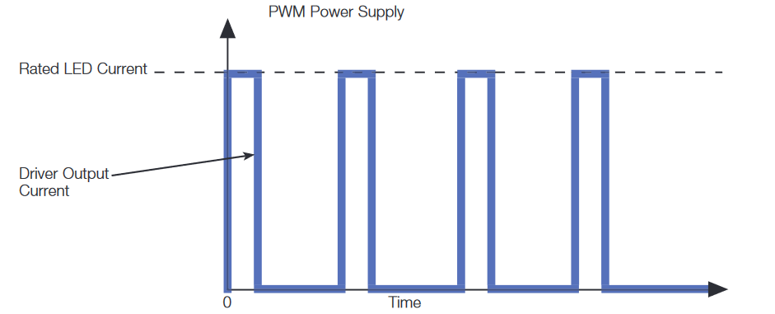
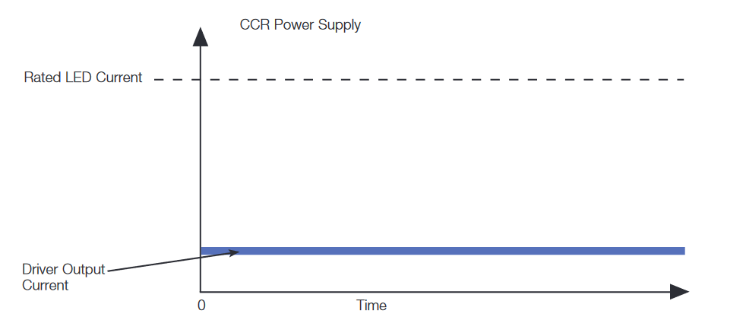
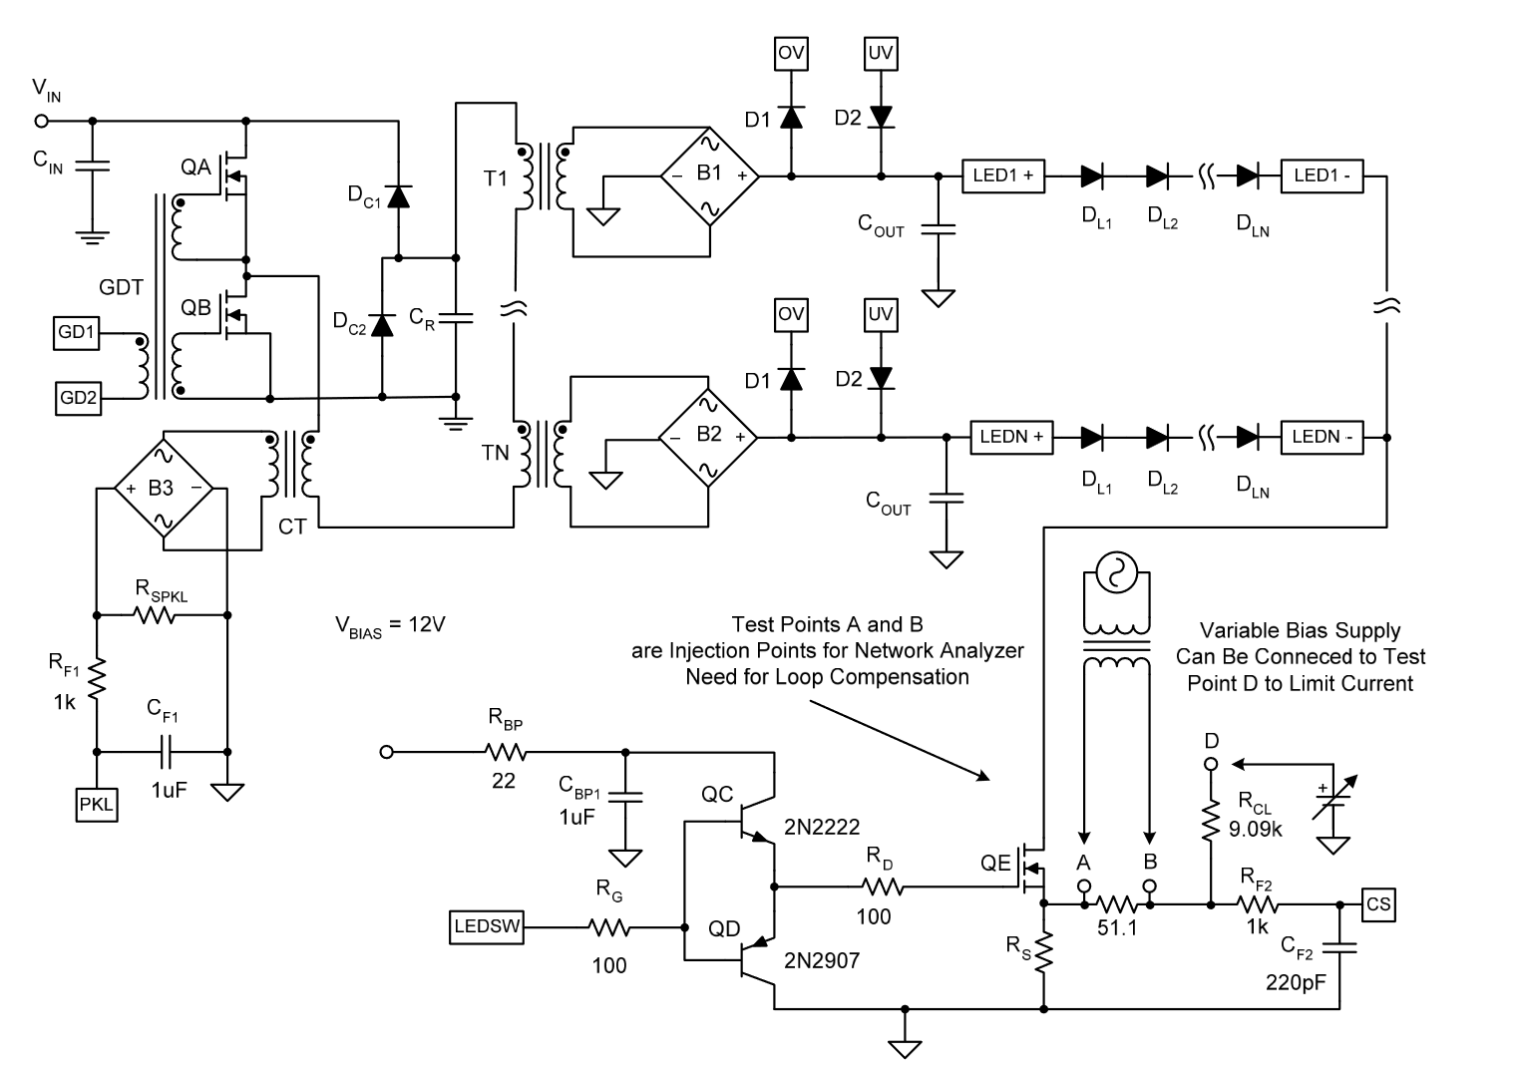
How do we actually drives (a lot of) LEDs?
1. PWM
2. CCR
With PWM techniques, luminous flux of LED can be reduced to less than 40% while remaining consistent color.
It a little bit complex, though.
NOTE: LED dimming is a suggested DIY project for this summer

Slide 14
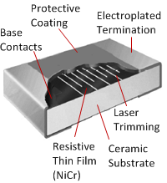
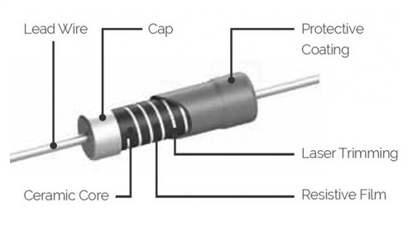
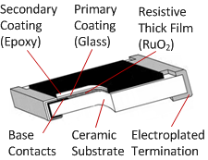
Classification by producing techniques
Thin film
薄膜电阻
Excellent high-frequency performance
High precision
Thick film
厚膜电阻
Cheap
(Relatively) High power rating

Slide 15
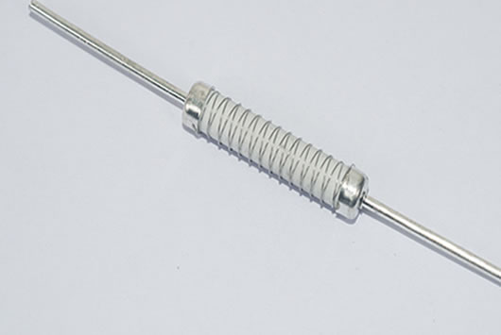
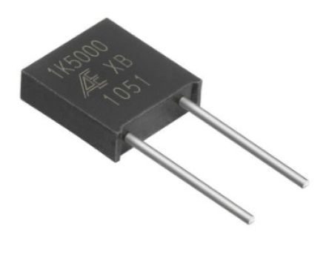
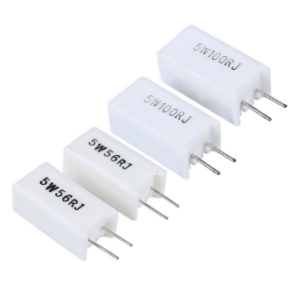
Classification by producing techniques
绕线电阻
Wiring Resistor
金属箔电阻
Metal Foil Resistor
水泥电阻
Ceramic Resistor

Slide 16
选用一只电阻
元件：一种描述其物理特性的数学模型 / 具有这种物理特性的物体
工艺：赋予材料物理特性
封装：工程上使用的元件，包括支撑、外壳、丝印等结构
阻值？
设计功率？
精度？
温度特性？
……
膜式
碳膜
薄膜
SMD
0402
电阻
Axial
0603
绕线式
金属膜
厚膜
MELF
0805
一只阻值为1kΩ的0805封装厚（碳）膜电阻器，工作温度是-10°C~60°C，允许误差±5%
1k 5% 0805
1k 0805
功率？0805：1/8W max

Slide 17
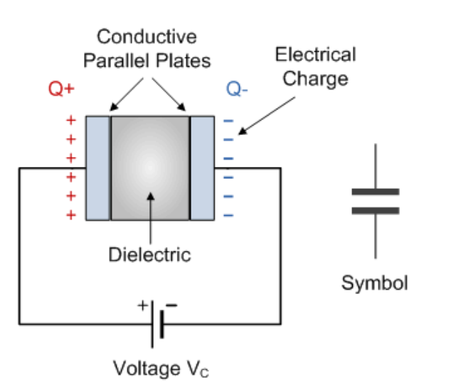
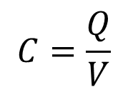
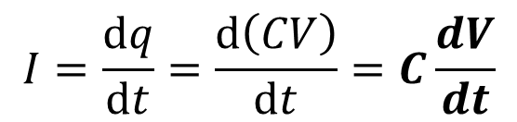
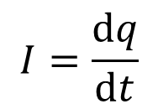
Capacitor 电容
$$C=\frac{Q}{V}$$
Charge quality 电荷量
It is defined as:
Voltage
For any component we are interested in its I-V characteristic
But we only got voltage here.
Recap: how is current defined?
$$I=\frac{dq}{dt}$$
Charge flows through some area within
an element of time
$$I=\frac{dq}{dt}=\frac{d\left(CV\right)}{dt}=C\frac{dV}{dt}$$
Assume that C is time-constant
Current flows through a capacitor is proportional to
The derivative of voltage over time / the voltage changing rate

Slide 18
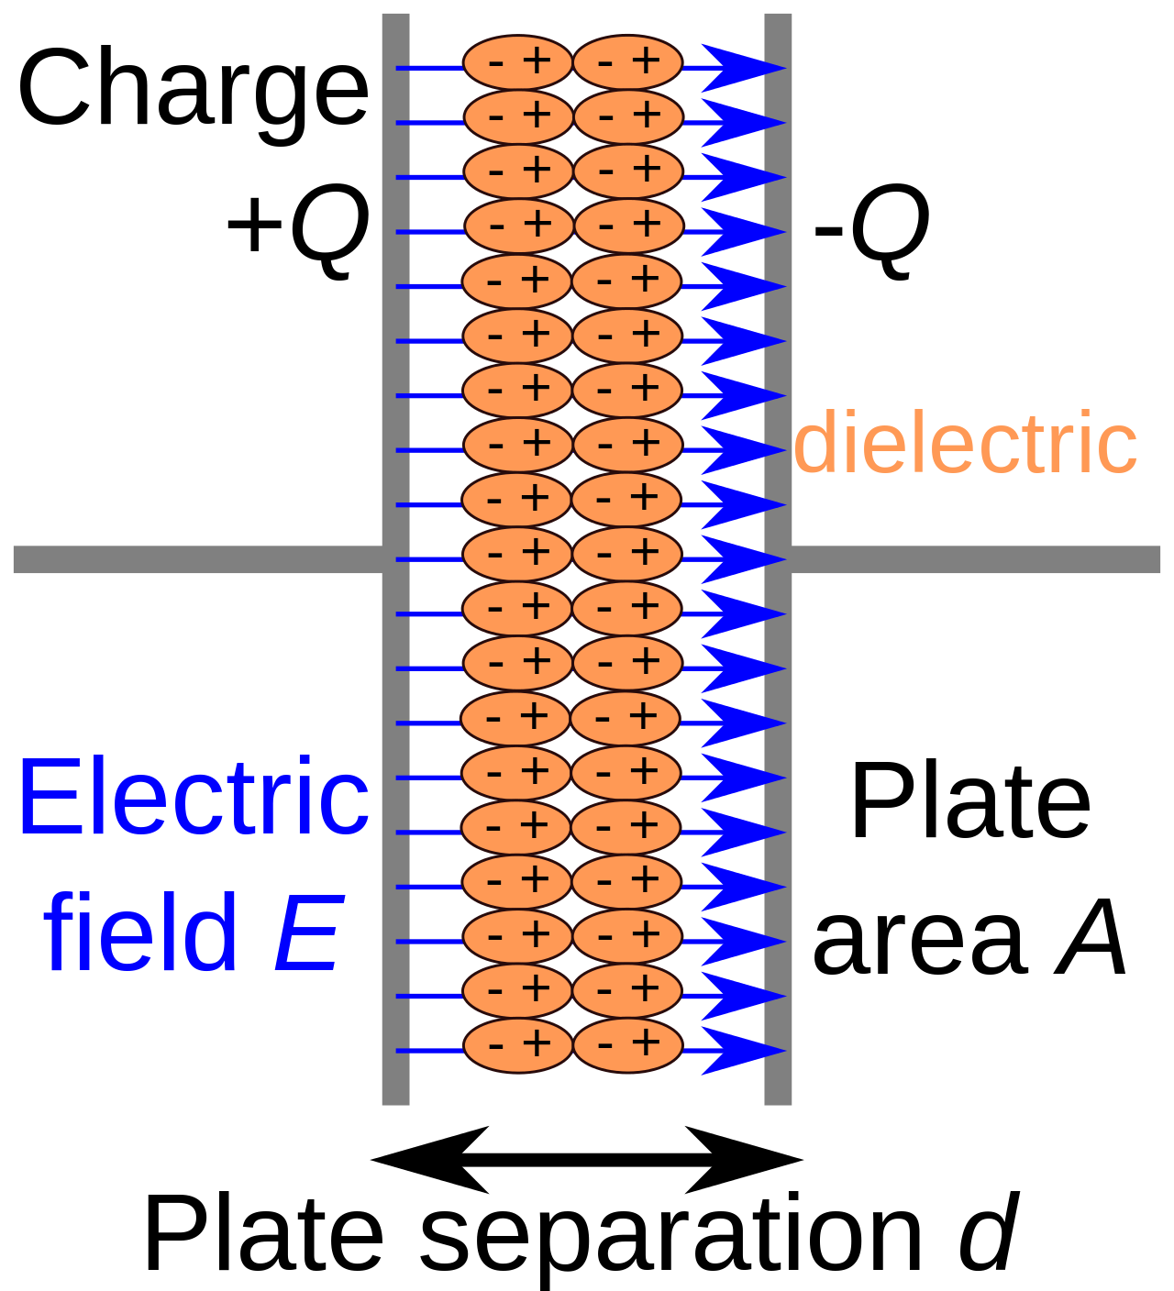
Capacitor 电容
Defination
Characterestic
parallel
series

Slide 19
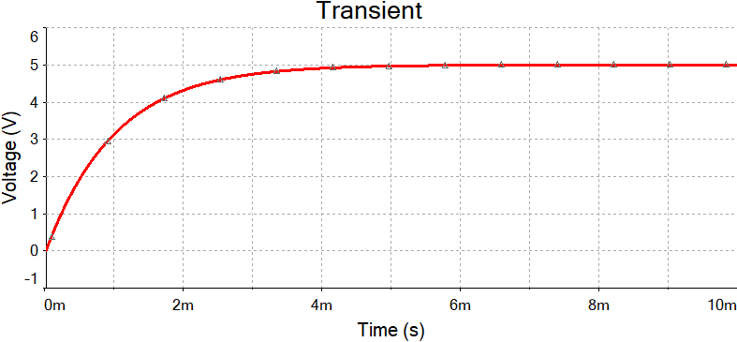
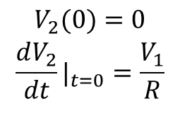




Plug a capacitor in DC supply
$$I=C\frac{{d\text{V}}_{2}}{dt}=\frac{V_{1}−V_{2}}{R}$$
$$\begin{matrix}\frac{dV_{2}}{dt}+\frac{1}{RC}V_{2}=\frac{1}{RC}V_{1} \\ \end{matrix}$$
$$\begin{matrix}V_{2}=K_{2}+K_{1}e^{−\frac{1}{RC}} \\ \end{matrix}$$
$$\begin{matrix}V_{2}(0)=0 \\ {\frac{dV_{2}}{dt}|}_{t=0}=\frac{V_{1}}{R} \\ \end{matrix}$$
$$\begin{matrix}V_{2}=V_{1}\left(1−e^{−\frac{1}{RC}}\right) \\ \end{matrix}$$
Boundary conditions, BCs

Slide 20



Plug a capacitor in AC supply
$$I=C\frac{{d\text{V}}_{2}}{dt}=\frac{V_{1}−V_{2}}{R}$$
Still stands, But V1 is now
$$V_{1}=Vsin\left(ωt+φ\right)$$
Transient State
Steady State
You may solve the ODE function, but it is really desperating when the circuit got complicated
In most cases we only care about the steady state, and there are easy tools to solve it.

Slide 21



Conclude the capacitor in a nut shell
隔直通交
$$I=C\frac{dV}{dt}=C\frac{d}{dt}\left(Vsin\left(ωt+φ\right)\right)$$
Forget about R1,
$$=ωCVsin\left(ωt+φ+90°\right)$$
We may define a property Reactance in letter X, just like the resistance
$$X_{C}=\frac{|V_{C}|}{|I_{C}|}=\frac{1}{ωC}$$
The higher the frequency, the lower the reactance of a capacitor.
You may consider it as a frequency-dependent resistor.
When f=0 (DC condition) and in steady state, Xc->∞. In other words it blocks DC current.
When f->∞ (high freq condition) and in ss, Xc->0. It conducts AC current.

Slide 22



MLCC Capacitors
1：金属电极
2：陶瓷电介质
3：金属端子

Slide 23




Electrolytic capacitors
阳极箔
电解质
阴极箔
Al2O3 电介质
电解纸
氧化物层
氧化处理过的阳极具有整流特性，被称为阈金属
不能在电解电容上施加反电压！

Slide 24



Other types
钽电解电容
Tantalum Capacitor
铌电解电容
Niobium Capacitor
薄膜电容
Film Capacitor
高分子聚合物电容
Polymer Capacitor
“固态电容”
Solid Capacitor

Slide 25



One application: Filter
Recoder
A 20kHz noise
A composition of sine wave
of 1k, 5k and 7kHz

Slide 26





Filter capacitors close to the chips
Where is the resistor in the RC filter?
Filter capacitors

Slide 27


Inductors
Defination
Characteristic
Series
Parallel

